Slide 1
Working With Assembly
Lessons from the Motorola 68000 assembly language by Josh Desmond

Slide 2
What was the project?
The Motorola 68000 is a CPU introduced in 1979.
It is still in use by the Ti-89 calculators.
My project was a “physics simulation” written in the language of the M68.

Slide 3
Project Itinerary:
Learn the language
Design an algorithm/Plan a project
Write the code

Slide 4
Learning the Language
Dissect code
Write code
Read the manual

Slide 5
Planning a Program
Write a flowchart
Code the program
Expand the program

Slide 6
How does it work?
Communication to windows for mouse input and graphics are handled externally
The physics loop deals only with velocity vectors and positions (with collision detection exceptions)
The graphics algorithm works by using length to build a square for each ball, then using an EASy68K directive to draw.

Slide 7
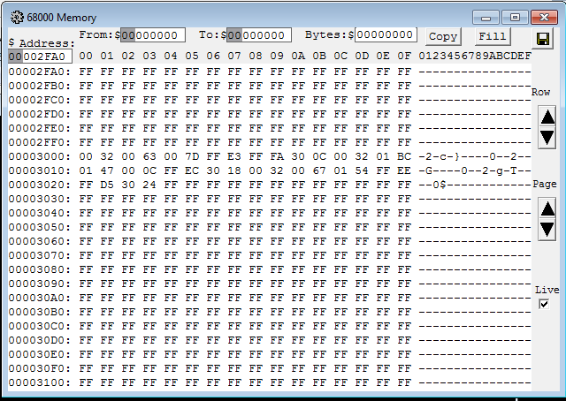
How does it work?: Memory

Slide 8
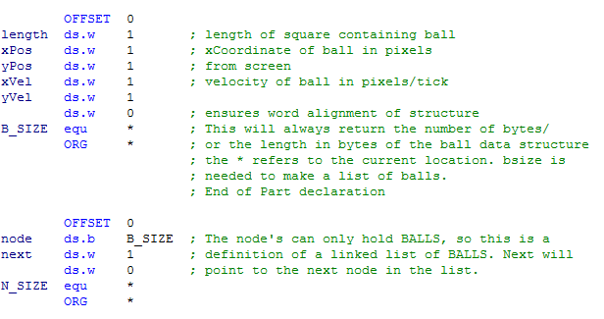
Ball Definition:

Slide 9
Ball Definition:
length: 0
xPos: 2
yPos: 4
xVel: 6
yVel: 8
B_SIZE: 10
node: 10
next: 12

Slide 10
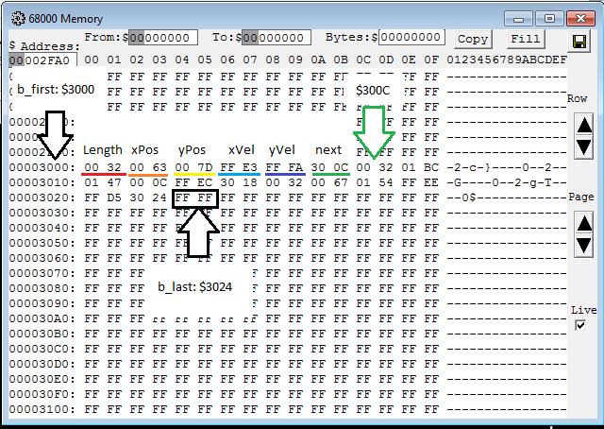
How does it work?: Memory

Slide 11
Commentary + Questions?

Slide 12
The end- Thanks!

